Slide 1
Quality and Productivity
Best friends forever
Joeri Sebrechts
js@mcs.fm
Notes:
The ignorant answer on how to improve quality is to just be more careful not to write bugs, and to test more thoroughly to find more bugs. Largely speaking, programmers are already being careful and testers are already being thorough, so why do we still have bugs?
Let's talk about what quality is, and how it is affected by project scale.

Slide 2
quality
/ˈkwɒlɪti/
noun
the standard of something as measured against other things of a similar kind
Notes:
Quality is a relative concept, not an absolute concept. There are levels of quality which are pointless to achieve (they cost more than they provide in benefit)
A software product with high quality does what people expect software products of that kind to do
Bugs are differences between user expectation and user experience. This covers not just classic bugs but also design defects, performance issues, usability issues, ...

Slide 3
It's always a bad time to scale
Notes:
This is a plot of MCS code size in functional lines of code, without third-party libraries. It is based on historical data and is extrapolated based on the current growth numbers.
The 12.0 release is the start of an accelerated growth. We added over 100.000 lines of code across windows and web. The myMCS webportal will be a million lines of code in 3 years time.
This is good news, and also bad news.

Slide 4
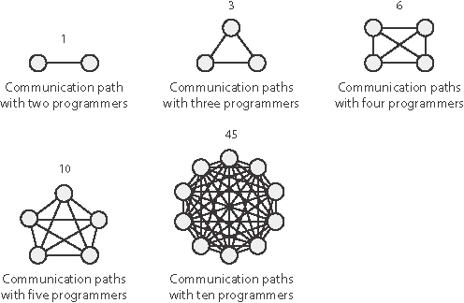
Scaling increases communication
Notes:
Communication scales exponentially with team size. You shouldn't scale teams beyond 9 people at most, because they automatically will break up into subteams. You end up building teams of teams (management hierarchy).
The larger the organization, the more communication is needed and the harder the challenge to manage communication effectively. Eventually the point is reached where people are no longer able to keep up to date with everything they need to know to do their job well.
When people stop communicating about necessary things, bad things happen.

Slide 5
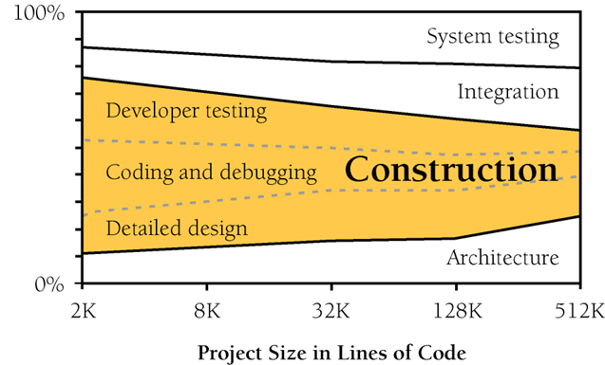
Scaling decreases productivity
(Code Complete 2nd ed – Steve McConnell)
Notes:
As projects scale, productivity drops due to coordination overhead (communication, design, ...)
Less and less time is spent on actual construction (< 50% on big projects)
Coding itself is a small percentage of the total effort (< 20% on big projects)

Slide 6
Scaling decreases quality
Defects per KLOC
Program Quality and Programmer Productivity (Jones 1977),
Estimating Software Costs (Jones 1998)
Notes:
As projects scale, quality decreases because of insufficient communication and more interactions between different parts of the system
However, there is a huge gap between the best and worst performers, which means this is something we can control

Slide 7
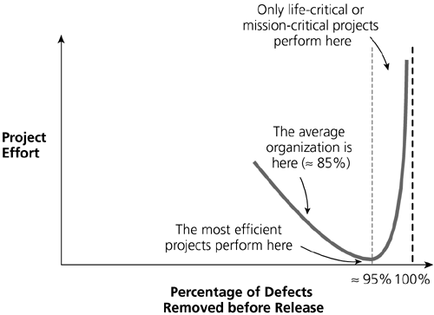
Quality == Productivity
(Applied Software Measurement, 2nd ed, Capers Jones 1997)
Notes:
A high level of quality is inextricably linked to a high level of productivity
Why is that? → next slide

Slide 8
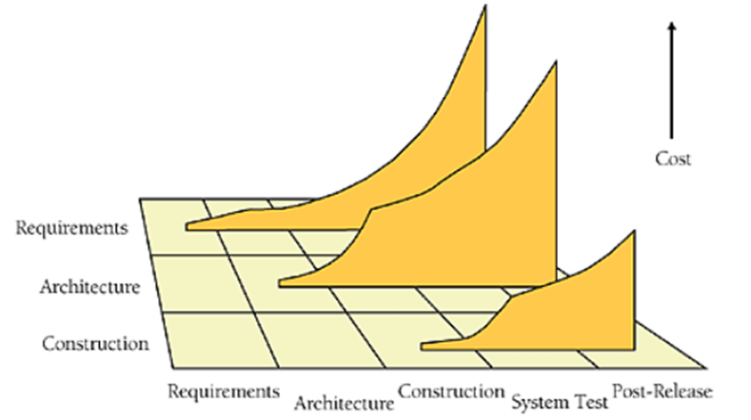
Bugs cost more when they live longer
Phase in which
defect is introduced
Phase in which defect is found
Notes:
A bug is expensive to fix if it reaches a tester (more test work needed)
A bug is more expensive to fix if it ships (need to deploy fix, more testing)
A bug is also more expensive to fix it was introduced in the design instead of in the code
The most expensive bugs are design flaws which ship to the customer.
Requirements and design problems account for 55% of all issues, and two thirds of high priority issues.
(Applied Software Measurement, 3rd ed, Capers Jones 2008)
IBM found that each hour of design review prevented about 100 hours of related work (testing and defect correction)
(Code Complete 2nd ed, chapter 21.1.1)
The sooner you can detect and kill bugs, the higher the productivity.
So, having a good FA and TA really matter a lot for both quality and productivity.

Slide 9
Why Agile? First law of users Iterative delivery
Notes:
Everything so far advocates doing a big design up-front. But then why are we doing agile / scrum?
The first law of users: users don't know what they want until they've seen what they don't want.
(This is why they say "build one to throw away")
We have to iterate, so that we can gradually discover the requirements together with the user.

Slide 10
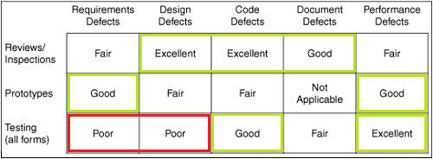
Top performers use the right strategy
Defect removal efficiency
(Applied Software Measurement, 3rd ed, Capers Jones 2008)
Notes:
You don't have the time to do everything all the time, spend resources wisely.
Prototypes are a good way to discover requirements during FA / TA and detect performance issues early on
Standard testing is good for finding code defects (code doesn't match design), but not good at finding design defects (because the tester focuses on what the spec says instead of what the user expects)
Design and code reviews are more efficient at removing requirements and design defects than any sort of after-the-fact testing.
Capers Jones found that software projects with 99% defect-removal rates or better all use formal reviews. No projects with < 75% defect-removal efficiency used formal reviews
(Code Complete, 2nd ed, chapter 21.1.1)

Slide 11
The laws of equality
High productivity = high quality
High quality = early detection of defects
Early detection = grooming (prototypes, design reviews)
Grooming = collective effort
Collective effort = sum of individual effort
Your individual effort matters!
Notes:
Never think "that's somebody else's problem". All problems are collective.

Slide 12
you are all individuals
just like everybody else
Notes:
Software development is a team sport, there is no room for ego. However, each individual brings their own unique set of skills to the team, so their skill set matters a lot.
The next slides talk about how you can improve your individual productivity so that the team as a whole may become more effective

Slide 13
Order-of-magnitude difference between programmers
(Code Complete 2nd ed – Steve McConnell)
Notes:
There are "rockstar" programmers who are literally ten times better than an average programmer.
Why is that? What can we learn from rockstar programmers?

Slide 14
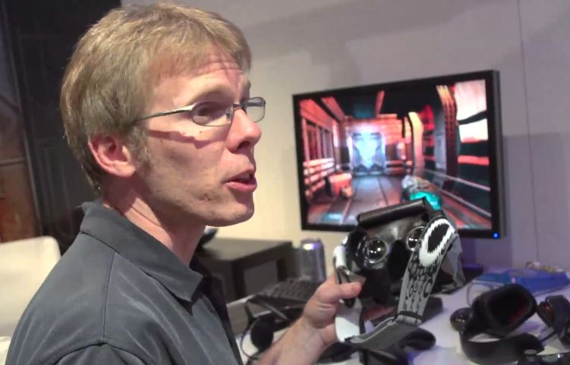
WWJD?
Notes:
Clip 1:
Still learning, majority of programming work is subjective, social science
Most things are opinion, not objectively right or wrong
Clip 2:
Programmers make mistakes all the time, regardless of best intentions
Even the objectively wrong stuff happens, and happens a lot at scale
Take-aways:
Assume all programmers write bugs and all code has bugs
Automate the detection of things that are objectively wrong to be able to focus on the real problems
Integration testing, unit testing, API design, performance benchmarks, ...
Code should be built around its assumed lifetime, with a cost/benefit trade-off for quality efforts
Building good software is an art and you need to work on the quality of individual work to reach quality as a team
Source:
http://blogs.uw.edu/ajko/2012/08/22/john-carmack-discusses-the-art-and-science-of-software-engineering/

Slide 15
Only human
The rider confabulates what the elephant decides
Wisdom = tacit knowledge
Illusory superiority
Bias blind spot
Notes:
Your subconscious (elephant) makes decisions guided by your conscious mind (rider). If the elephant decides to go somewhere else, your conscious mind will follow it. It's impossible to do things fully consciously (try consciously opening a door, thinking deliberately about every muscle action that it involves)
Confabulation: study of people with split brain syndrome (brain halves don't communicate)
Basically two people sharing a body, but only one of them can talk (talking is specific to one brain half). (Mention alien hand syndrome)
Shown a different image for each brain half first, then shown the same set of images to both halves, asked to choose what matches the first image.
The patient’s right hand pointed to a picture of a chicken (which went with the chicken claw the left hemisphere had seen), but the left hand pointed to a picture of a shovel (which went with the snow scene presented to the right hemisphere). When the patient was asked to explain his two responses, he did not say, “I have no idea why my left hand is pointing to a shovel; it must be something you showed my right brain.” Instead, the left hemisphere instantly made up a plausible story. The patient said, without any hesitation, “Oh, that’s easy. The chicken claw goes with the chicken, and you need a shovel to clean out the chicken shed.”
(The Happiness Hypothesis, Jonathan Haidt)
When you see a painting, you usually know instantly and automatically whether you like it. If someone asks you to explain your judgment, you confabulate. You don’t really know why you think something is beautiful, but your interpreter module (the rider) is skilled at making up reasons.
In many debates, people invent arguments to sustain their intuitive belief
Explicit knowledge = known by the rider, conscious decisions
Tacit knowledge = known by the elephant, subconscious decisions
The ability for subconscious correct decision-making is key to productivity (otherwise too much decisions are needed)
Illusory superiority: we think we're better than we are (a.k.a. dunning-kruger effect)
http://en.wikipedia.org/wiki/Illusory_superiority
87% of MBA students at Stanford University rated their academic performance as above the median.
Consistent results between 70% and 90% in other studies (e.g. driving safety)
We have to consciously counter our ego bias
But there is a risk here, we start out ignorant and confident, then we learn our limits and become insecure.
→ The challenge is not to freeze up due to insecurities and let those who are still ignorant make decisions for us.
Bias blind spot: we think we don't have the biases that we do
http://en.wikipedia.org/wiki/Bias_blind_spot
Coin flipping experiment (Happiness Hypothesis): 90% report an unseen coin flip went their way

Slide 16
Train your elephant
We are dominated by subconscious decisions
We make mistakes all the time without realizing it
We are in denial about those mistakes
We invent excuses for those mistakes
We mistakenly claim we don't make mistakes
→ Good habits are the key to fewer mistakes, better productivity
Notes:
You cannot consciously decide to make fewer mistakes, you have to train your subconscious to make better decisions
Remember that bad quality == bad productivity. If we can make fewer mistakes, we'll have fewer bugs and therefore have better productivity.
Individual decisions to improve habits compound over time to create a super-productive team creating high-quality products.

Slide 17
Good habits
Never stop learning / thinking / reflecting
Plan the dive, dive the plan
Single todo list with priorities
Helps you focus on one thing, humans are bad at multi-tasking
Code plan / unit test before coding, test plan before testing
Helps you to check your assumptions, verify subconscious decisions
Assume code has to live a decade
Try to find flaws, assume the worst
Notes:
Write a design/unit test before coding = think things through, solve roadblocks ahead of time
Assume you write bugs = be paranoid about your own work
Stakeholders:
people who care about this code
people who use this feature, or plan to use this feature
Communicate progress, or lack of progress, bad news is better than no news

Slide 18
Good habits (2)
Assume you've just written a bug
Static code validation (jshint, phpstorm inspections, php –l)
Pre-commit hooks
Unit testing, TDD, code coverage
Ask for opinions or peer review if uncertain
Always test before you commit
Work in small increments

Slide 19
Good habits (3)
Treat programming as a social science
Respect the work of others
Keep people informed about changes to their code (before, during and after)
Inform the stakeholder / customer
Signal the status, good or bad.
Discern objective from subjective decisions
Learn to recognize when you're bikeshedding
Notes:
When you want to change someone else's code, make sure you give them a heads up about this, so they can give you valuable input. It slows you down a little, but it avoids a lot of annoying debate, and it avoids mistakes because you don't know the code as well as they do.
Very often customers just want to be told you're working on their problems. It doesn't make the work go any faster, but it makes them feel better, so just do it.
Bikeshedding: while designing a building, spending a lot of time discussing the color of the bikeshed. If the discussion doesn't add value for the user, it's better to choose arbitrarily (coin toss) and move on to more productive work.
Some people are better at this than others: teams should find the right people to do their communication

Slide 20
Ask questions effectively
Ask actual questions
Don't just describe problems in a long wall of text
What have you tried already?
Where have you looked already? (Confluence, Google, ...)
Plan ahead
Detect missing info ahead of time, ask for it before you need it
Avoid interrupting
Maximally use asynchronous channels (email, skype)
Maximally use existing meetings (stand-ups)
But interrupt if you're stuck (don't wait)

Slide 21
Answer questions effectively
Avoid downtime
Make sure people aren't blocked
Always provide some answer, if not the answer
Forward → tell askers the right person to answer their question
Plan → tell askers when you'll have time to answer
Educate → tell askers where to find answers themselves
Don't repeat yourself
Create documentation, organize knowledge sharings
Manage your time
Teach askers to ask questions effectively
Convert questions into todo list items
Notes:
The more people ask you questions the harder this becomes to do right.

Slide 22
Quality is never an accident.
It is always the result of intelligent effort.
There must be the will
to produce a superior thing.
John Ruskin (1819 – 1900)
Notes:
John Ruskin was an art critic and well-publicized thinker from the 19th century

Slide 23
Thank you!
js@mcs.fm
joind.in/10475
github.com/jsebrech

